Slide 1
SQL Server Services

Slide 2

About the Author
Created By: | Sucharita Das (241163) & Rajalaxmi (301159)
Credential Information: | 8+ years of SQL Server developer/architect experience
Version and Date: | SS2008/0611/1.0
Cognizant Certified Official Curriculum

Slide 3









Icons Used
Hands on Exercise
Questions
Tools
Coding Standards
Test Your Understanding
Reference
A Welcome Break
Contacts
Demonstration

Slide 4
Objective
You get to know the SQL Server Services

Slide 5
SQL Server Services
MS SQL Server Service
SQL Server Analysis Service
SQL Server Integration Service
SQL Server Reporting Service
SQL Server Agent
SQL Server Browser
SQL Server Full Text Search

Slide 6
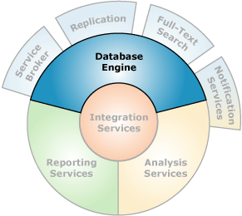
MS SQL Server Service
Is the core service for storing,
processing, and securing data.
SQL Server supports multiple
MS SQL Service instances.
Types of instances :
Default
Named
There can be only one default instance but several named instances.

Slide 7
MS SQL Server Service
Instance Names:
No of Named Instances:
Default instance | Named instance
MSSQLServer | MSSQ$InstanceName
Express edition | Standard edition
50 | 16

Slide 8
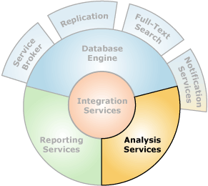
SQL Server Analysis Service
Provides the basis of a powerful business intelligence solution that supports Online Analytical Processing (OLAP) applications and data mining.
No of named Instances:
Standard Edition | Express Edition
16 | 50

Slide 9
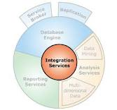
SQL Server Integration Service
Allows to perform data migration and data integration
Done using Business Intelligence Development Studio (BIDS).
In the current release of Integration Services, you can deploy your projects to the Integration Services server.

Slide 10
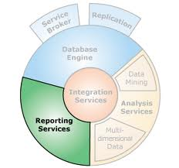
SQL Server Reporting Service
Applied to extract data from SQL Server and generate reports
No of Named Instances:
Standard Edition | Express Edition
16 | 50

Slide 11
SQL Server Agent
SQL Server Agent uses SQL Server to store job information.
Jobs contain one or more job steps.
Each step contains its own task, for example, backing up a database.

Slide 12
SQL Server Browser
Listens for incoming requests for Microsoft SQL Server resources and provides information about SQL Server instances installed on the computer.
SQL Server Browser contributes to the following actions:
Browsing a list of available servers
Connecting to the correct server instance
Connecting to dedicated administrator connection (DAC) endpoints

Slide 13
SQL Server Full Text Search
Enables fast and flexible indexing for queries based on keyword of text data stored in a SQL Server database.

Slide 14
Questions

Slide 15
Summary
There can be only one default instance but several named instances.
SQL Server Agent uses SQL Server to store job information.
SQL Server Browser is equivalent to Listener Process in Oracle.
SQL Server Browser acts a windows service to the SQL Server.

